Slide 1
Apache Zookeeper
Chenhan Chung
Ayushmat Bhardwaj Soni

Slide 2

What is Apache Zookeeper?
It basically keeps track of information that must be synchronized across your cluster.
Which node is the master?
Which tasks are assigned to which workers?
Which workers are currently available?
It is a tool that applications can use to recover from partial failures in your cluster.
It is an essential part of Hbase, Storm, Drill and many more.

Slide 3
What are Failure Modes?
Failure can occur in any of the nodes in a system.
Master crashes: System needs to fall over to a backup
Worker crashes: Its work and jobs needs to be redistributed in others.
Network Trouble: part of the cluster cannot see the rest of cluster because of any network failure. It can be due to physical damage or any other reason.
Master
Worker
Worker
Worker

Slide 4
Primitive operations in a distributed system
Master Election
One node registers itself to a master, holds a “Lock” on that data
Other nodes cannot become a master until that lock is released
Only one node allowed to the lock at a time
Crash Detection
“Ephemeral” (Temporary) data on a node’s availability automatically goes away if the node disconnects or fails to refresh itself after some time-out period
Group Management
Metadata
List of outstanding tasks and assignments.

Slide 5
But Zookeeper’s API is not about these primitives
Instead they have a built a general purpose system that makes it easy for applications to implement them.

Slide 6
Zookeeper’s API
Here a simple visualization of Zookeeper API.
/
/Master
/Workers
Worker = 1
Worker = 2
Worker = 3

Slide 7
Notifications
A client can register for notification on a z-node.
Avoids continuous polling
Example:
Register for notification on /master – if it goes away, try to take over as the new master.
Z-node is just a file that contain information which needs to be shared across the nodes in a group (e.g. group of NameNodes, group of message processing nodes). Any node from the group can watch this z-node to monitor the change in information stored in it.

Slide 8
Leader Selection
How would you elect a master if an existing master node fails?
This can be easily achieved using Zookeeper server.
Example:
In three node cluster Node1 is a master node, which will sever all the requests. However, this node can fail. Hence, when Node1 fails than immediately in less than a second Zookeeper can mark Node1 as a failure and another node remaining between Node2 and Node will become master node.
Node 1
Node 2
Node 3
Zookeeper

Slide 9
Persistent and Ephemeral Znodes.
Persistent z-nodes remain stored until explicitly detected.
I.e. Assignment of tasks to workers must persist even if master crashes.
Ephemeral z-nodes go away if the client that created it, crashes or loses its connection with zookeeper
I.e. if the master crashes, it should release all of its locks on the z-node that indicates which node is the master.

Slide 10
Zookeeper Architecture
ZK Server
Master
ZK CLIENT
Worker
ZK CLIENT
Worker
ZK ClIENT
Worker
ZK CLIENT
ZK Server
ZK Server
Zookeeper
Ensemble
ZK Server
ZK Server
ZK Server
Clients have a list ZK servers to connect to

Slide 11
Zookeeper Quorums
ZK Server
ZK Server
ZK Server
ZK Server
ZK Server

Slide 12
Zookeeper Installation and Configurations

Slide 13
Zookeeper Installation and Configurations
The following steps are used to install Zookeeper on Windows Machine:
Download and Extract Apache Zookeeper using 7-Zip
Download: http://zookeeper.apache.org/releases.html#download
JRE is required to run Apache Zookeeper.
The following steps require the following system requirements:
Windows 64-bit
Apache Zookeeper 3.7.x (Latest Stable build)

Slide 14
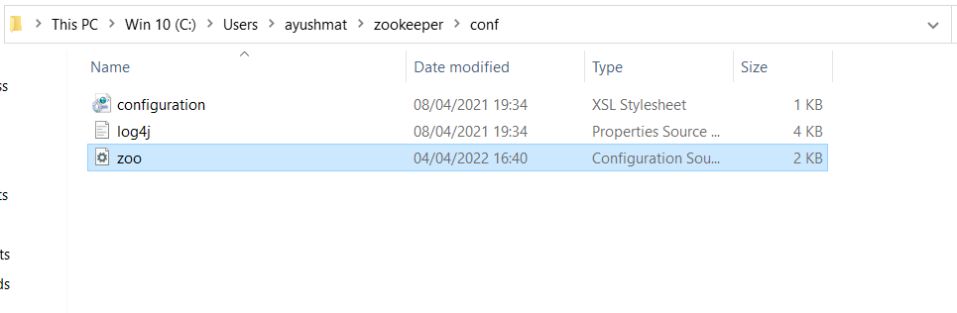
Zookeeper Installation and Configurations
Instructions:
Copy and Rename “zoo_sample.cfg” to “zoo.cfg” in C:\Users\ayushmat\zookeeper\conf

Slide 15
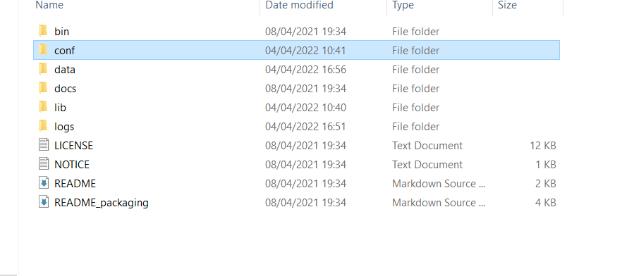
Zookeeper Installation and Configurations
Instructions:
Create data directory in zookeeper folder.

Slide 16
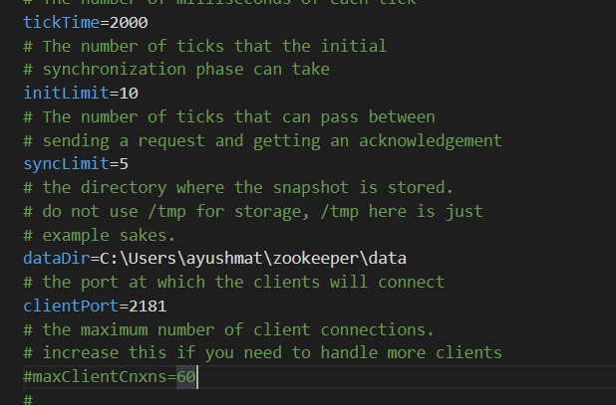
Zookeeper Installation and Configurations
Instructions:
Find & edit dataDir and add your newly created address in the confg file.
Once the configuration file has been saved successfully, go to the terminal again. You can now start the zookeeper server.

Slide 17
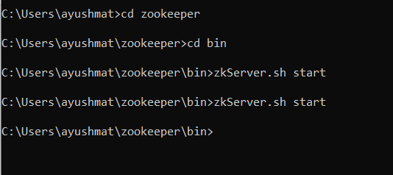
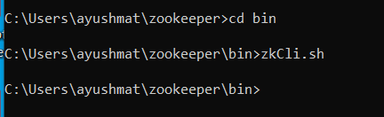
Zookeeper Installation and Configurations
Instructions:.
Open command prompt and type zkserver.sh start, it will start the zookeeper.

